Slide 1
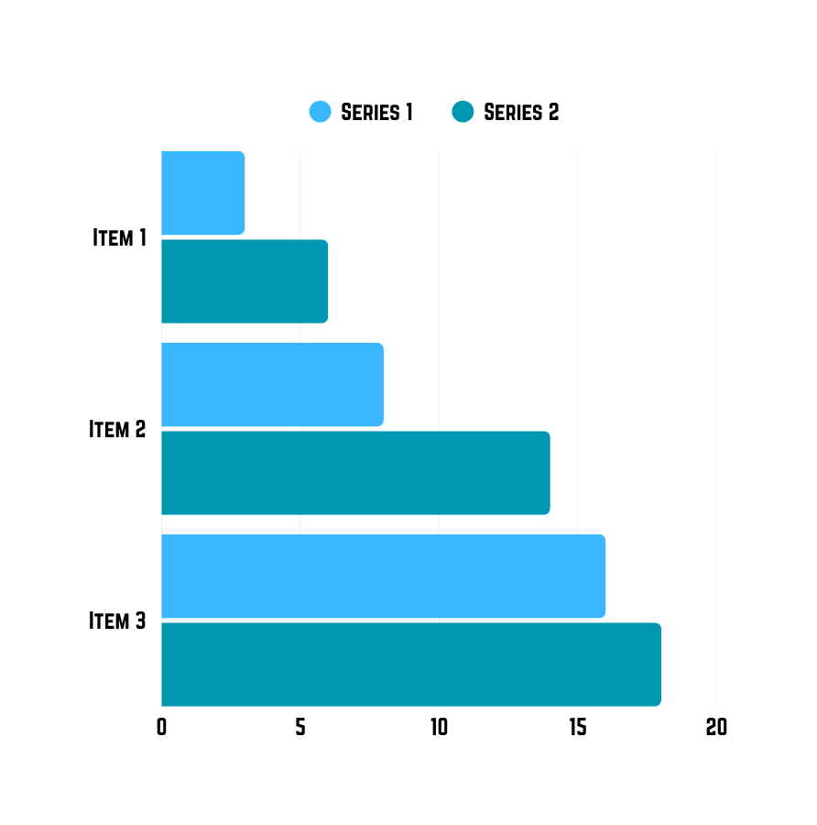
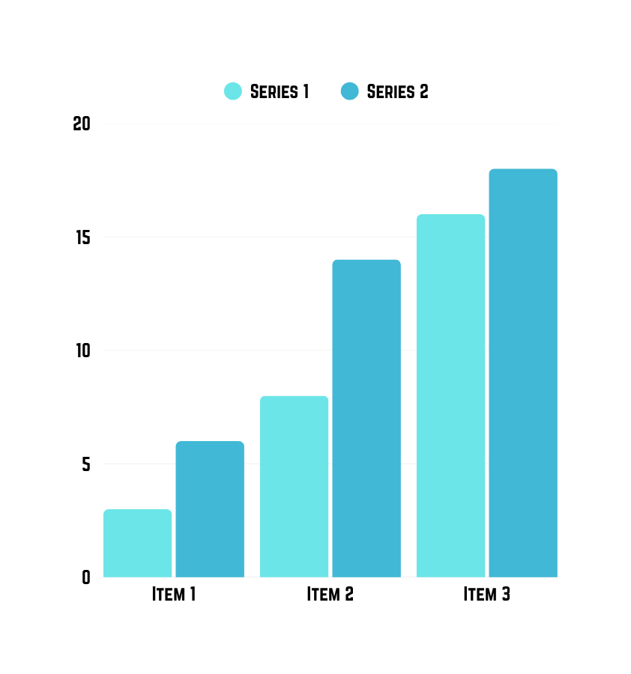
Varendra University Interdisciplinary Research Fest 2025
Title:Template of Research Poster
RESULTS
Author’s Name and Affiliation
The study investigated the role of protein XYZ in insulin resistance. A sample of 20 insulin resistant rats was used, and the protein was extracted from them. A western blot analysis revealed a correlation between the levels of glycosylated XYZ and insulin resistance markers. The researchers also conducted additional experiments to further explore the relationship between protein XYZ and insulin resistance. They examined the effects of different doses of XYZ on insulin sensitivity in rats and observed significant changes in glucose metabolism. Furthermore, the study investigated the molecular mechanisms underlying the association between XYZ and insulin resistance by analyzing the expression of key genes involved in insulin signaling pathways. The findings suggest that protein XYZ plays a crucial role in the development and progression of insulin resistance, providing valuable insights for potential therapeutic interventions.
Abstract
The abstract should be clear and concise, highlight the main objectives, a brief methodology statement and key findings with its policy implications. Please write your abstract within 200 words.
Key Words: at least three
INTRODUCTION
MATERIALS & METHODS
Insulin resistance is a metabolic condition that contributes to diseases like type 2 diabetes. Understanding its mechanisms is crucial for effective treatments. To further elaborate on this topic, it is important to note that insulin resistance is often associated with obesity, high blood pressure, and dyslipidemia. Additionally, research has shown that insulin resistance can also lead to an increased risk of cardiovascular diseases, such as heart attacks and strokes.
A sample of 20 insulin resistant rats was used for the experiment. The protein was extracted and analyzed using western blot analysis. Gel electrophoresis separated the components based on their molecular weight. The protein bands were then transferred onto a membrane and probed with specific antibodies to detect the protein of interest. Protein expression levels were quantified using image analysis software.
Title of chart
Title of chart
Title of Figure
Conclusion
These findings contribute to our understanding of the molecular mechanisms underlying insulin resistance and offer potential avenues for developing new treatment strategies.
Recommendation
These findings contribute to our understanding of the molecular mechanisms underlying insulin resistance and offer potential avenues for developing new treatment strategies.
Center for interdisciplinary Research
References
Varendra University
"Insulin resistance and its role in metabolic disorders" by DeFronzo RA, Ferrannini E."
Insulin resistance and cardiovascular disease" by Reaven GM."
Insulin resistance and type 2 diabetes mellitus" by Kahn SE, Hull RL, Utzschneider KM.

